Slide 1
System calls for Process management
Process creation, termination, waiting

Slide 2
System calls
Fork()
Exec()
Wait()
Exit()

Slide 3
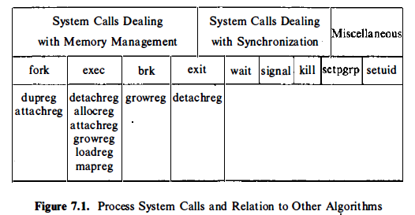
System calls their corresponding low level algorithms

Slide 4
Creating a Process in UNIX
pid = fork();
UNIX kernel
Process Table
…
Process Descriptor

Slide 5
Fork()
Will spawn a new child process which is an identical process to the parent except that has a new system pid
The process is copied in memory from the parent and a new process structure is assigned by the kernel

Slide 6
Fork()
It takes no arguments and returns a process ID.
After a new child process is created, both processes will execute the next instruction following the fork() system call.
Therefore, we have to distinguish the parent from the child. This can be done by testing the returned value of fork():
The return value to the parent process will be the Process ID (PID) of the child, whilst the child will get a return value of 0.

Slide 7
The kernel does the following sequence of operations for fork
I . It allocates a slot in the process table for the new process.
2. It assigns a unique ID number to the child process.
3 . It makes a logical copy o f the context o f the parent process. Since certain portions of a process, such as the text region, may be shared between processes, the kernel can sometimes increment a region reference count instead of copying the region to a new physical location in memory.
4. It increments file and i-node table counters for files associated with the process.
5 . It returns the ID number o f the child t o the parent process, and a 0 value to the child process.

Slide 8
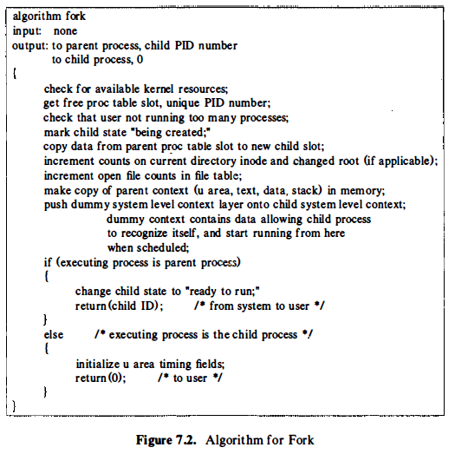

Slide 9
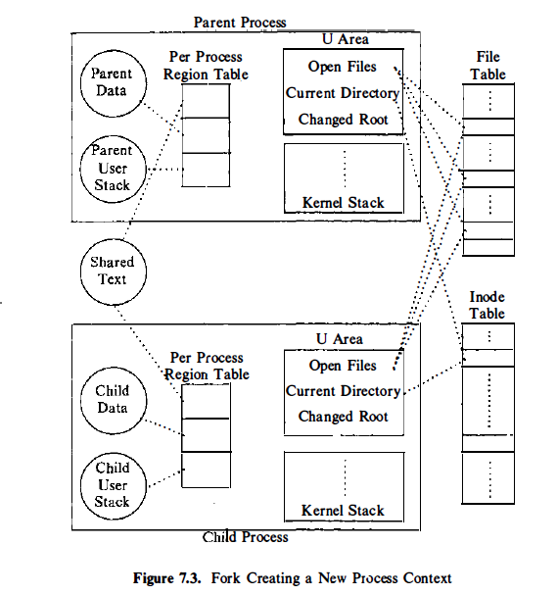
Logical view of parent and child processes and their relationships to other kernel data structures immediately after completion of the fork system call

Slide 10
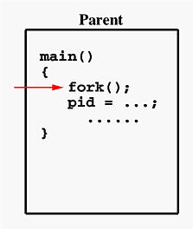
example
If the call to fork() is executed successfully, Unix will make two identical copies of address spaces, one for the parent and the other for the child.
Both processes will start their execution at the next statement following the fork() call.
In this case, both processes will start their execution at the assignment statement as shown below

Slide 11
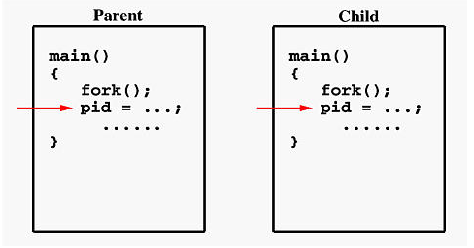
Both processes start their execution right after the system call fork(). Since both processes have identical but separate address spaces, those variables initialized before the fork() call have the same values in both address spaces.
Since every process has its own address space, any modifications will be independent of the others.
In other words, if the parent changes the value of its variable, the modification will only affect the variable in the parent process's address space.

Slide 12
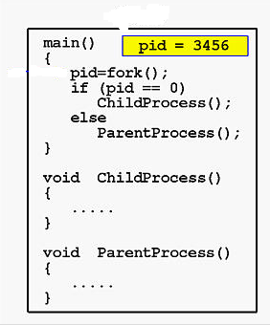
Sample program

Slide 13
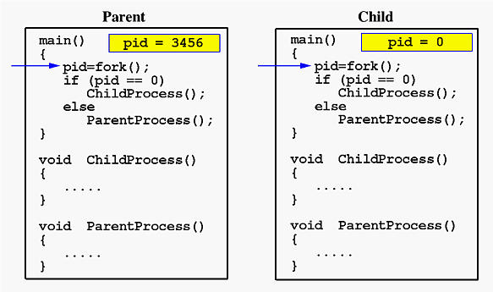

Slide 14
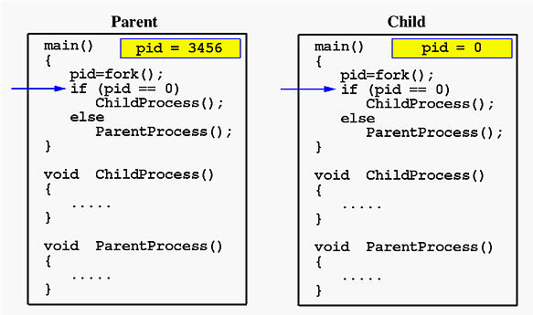

Slide 15
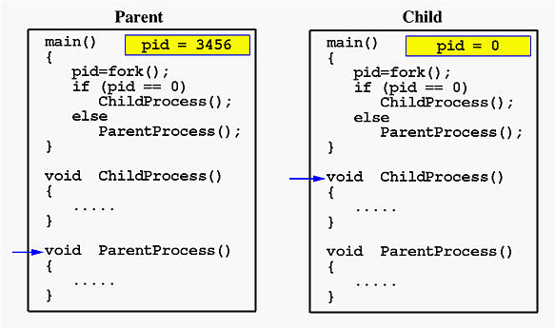

Slide 16
A few additional notes about fork():
an orphan is a child process that continues to execute after its parent has finished execution (or died)
to avoid this problem, the parent should execute a wait system call

Slide 17
Forking provides a way for an existing process to start a new one, but what about the case where the new process is not part of the same program as parent process?
This is where the exec system call comes into play. exec will replace the contents of the currently running process with the information from a program binary

Slide 18
Exec
"The exec family of functions replaces the current process image with a new process image.“
Commonly a process generates a child process because it would like to transform the child process by changing the program code the child process is executing.
The text, data and stack segment of the process are replaced and only the u (user) area of the process remains the same.

Slide 19
Exec versions
The versions of exec are:
execl
execv
execle
execve
execlp
execvp
The naming convention: exec*
'l' indicates a list arrangement (a series of null terminated arguments)
'v' indicate the array or vector arrangement (like the argv structure).
'e' indicates the programmer will construct (in the array/vector format) and pass their own environment variable list
'p' indicates the current PATH string should be used when the system searches for executable files.

Slide 20
Wait system call
A parent process usually needs to synchronize its actions by waiting until the child process has either stopped or terminated its actions. The wait() system call allows the parent process to suspend its activities until one of these actions has occurred. If any child processes are still active, the calling process will suspend its activity until a child process terminates.

Slide 21
Sample program for wait()
int status;
pid_t fork_return;
fork_return = fork();
if (fork_return == 0) /* child process */
{
printf("\n I'm the child!");
exit(0);
}
else /* parent process */
{
wait(&status);
printf("\n I'm the parent!");
if (WIFEXITED(status))
printf("\n Child returned: %d\n", WEXITSTATUS(status));
}

Slide 22
A few notes on this program:
wait(&status) causes the parent to sleep until the child process is finished execution
details of how the child stopped are returned via the status variable to the parent.

Slide 23
How Linux actually handles fork and exec
Clone () system call
In the kernel, fork is actually implemented by a clone system call. This clone interfaces effectively provides a level of abstraction in how the Linux kernel can create processes.
clone allows you to explicitly specify which parts of the process are copied into the new process, and which parts are shared between the two processes. This may seem a bit strange at first, but allows us to easily implement threads with one very simple interface.

Slide 24
Clone ( ) System Call
Thread
clone(CLONE_VM | CLONE_FS | CLONE_FILES |
CLONE_SIGHAND, 0);
• Process with fork( )
clone(SIGCHLD, 0);
Process with vfork( )
clone(CLONE_VFORK | CLONE_VM | SIGCHLD, 0);

Slide 25
Exit()
The exit operation typically performs clean-up operations within the process space before returning control back to the operating system.
When the child process terminates ("dies"), either normally by calling exit, or abnormally due to a fatal error or signal (e.g., SIGTERM, SIGINT, SIGKILL), an exit status is returned to the operating system and a SIGCHLD signal is sent to the parent process.
The exit status can then be retrieved by the parent process via the wait system call.

Slide 26
Orphans and zombies :
operating systems handle a child process whose parent process has terminated in a special manner. Such an orphan process becomes a child of a special process,
A similar strategy is used to deal with a zombie process, which is a child process that has terminated but whose exit status is ignored by its parent process. Such a process becomes the child of a special process, which retrieves the child's exit status and allows the operating system to complete the termination of the dead process.

Slide 27
#include <stdlib.h>
5
int main(void)
{
pid_t pid;
10 printf("parent : %d\n", getpid());
pid = fork();
if (pid == 0) {
15 printf("child : %d\n", getpid());
sleep(2);
printf("child exit\n");
exit(1);
}
20
/* in parent */
while (1)
{
sleep(1);
25 }
}
ianw@lime:~$ ps ax | grep [z]ombie
16168 pts/9 S 0:00 ./zombie
30 16169 pts/9 Z 0:00 [zombie] <defunct>

